Slide 1






Foundations of
Quantum Information Science (QIS 101)
Dave Biersach
Brookhaven National Laboratory
dbiersach@bnl.gov
Session 02
Installing the Courseware

Slide 2
Preparing for the QIS101
During this course you will be writing software using Python running IBM Qiskit inside Jupyter Lab Notebooks
To properly setup a local Python development environment on your personal computer, we will use free & open-source tools like Git, Miniconda, and Visual Studio Code
If you have already installed these applications on your own computer, you may not need to reinstall them, but please ensure you are running the most up-to-date versions of these applications
Note: If you already have the full Anaconda distribution on your computer, you do not need to also install Miniconda

Slide 3
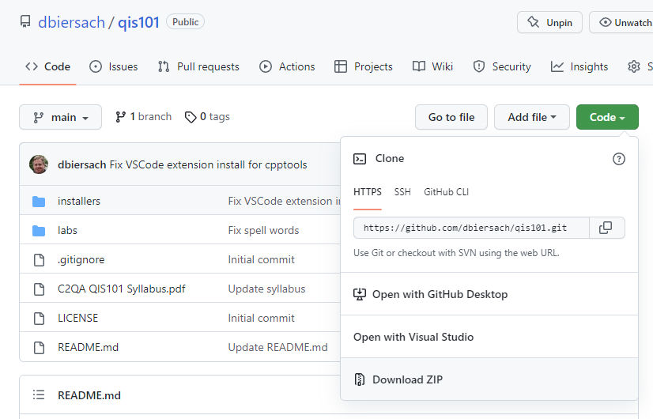
Downloading the Courseware
Note: The courseware can be manually downloaded as a large single ZIP file from https://github.com/dbiersach/qis101

Slide 4
Installing the QIS101 Courseware
If running Microsoft Windows, go to slide #5
If running Apple macOS, go to slide # 24
If running Ubuntu Linux, go to slide # 44
If running Google Chromebook Linux, go to slide # 63
If you run into problems,
see the Troubleshooting Tips
at the end of this slide deck
Note: Your output may not look exactly like the following screen shots

Slide 5
Microsoft Windows – Phase 1
You must be running 64-bit Windows 10 (or later) with an Intel CPU and a minimum of 10GB of free disk space - you will need local administrator rights on your machine
Step 1 – Install the latest (non-preview) PowerShell 7 (or later) version using its associated PowerShell-#.#.#-win-x64.msi file (in the Assets section) at https://github.com/PowerShell/PowerShell/releases
Step 2 - Run the Standalone Installer 64-bit Git for Windows Setup at https://git-scm.com/download/win
Step 3 – Install the latest Miniconda3 Windows (64-bit) at https://repo.anaconda.com/miniconda/Miniconda3-latest-Windows-x86_64.exe

Slide 6
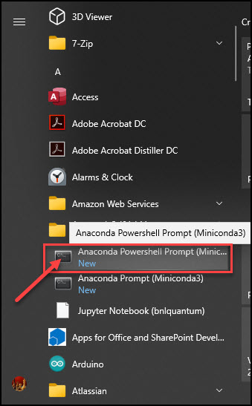
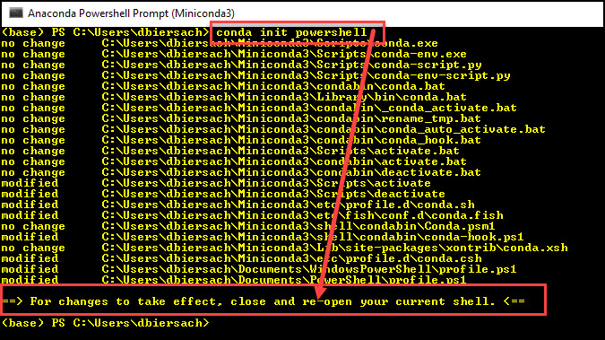
Microsoft Windows – Phase 1
Step 4 - Launch an Anaconda PowerShell Prompt:
Step 5 – Enter the command
conda init powershell
Step 6 – Close this PowerShell window

Slide 7
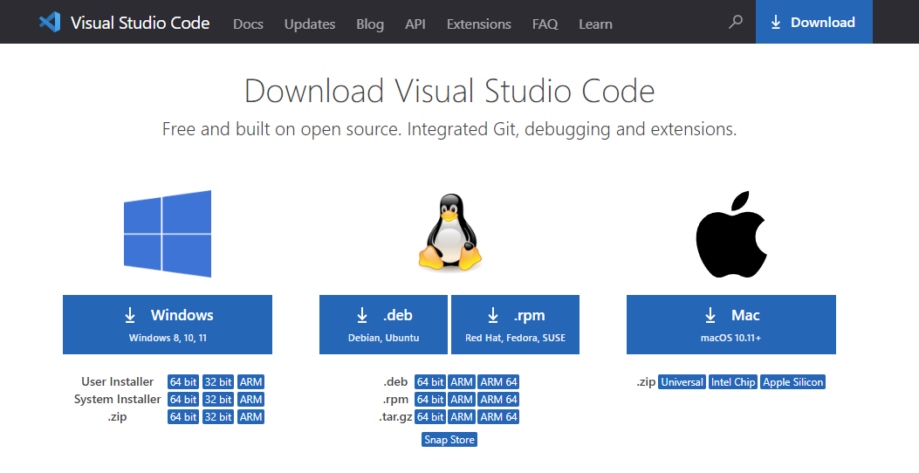
Microsoft Windows – Phase 1
Step 7 – Install the Windows 64-bit System Installer version for VS Code from https://code.visualstudio.com/Download

Slide 8
Microsoft Windows – Phase 2
After Phase 1 completes, start a new PowerShell session and then
execute these six commands (one line at a time):
Set-ExecutionPolicy RemoteSigned -Scope CurrentUser
conda update -y -n base conda
cd $HOME
git clone https://github.com/dbiersach/qis101
cd $HOME/qis101/installers
.\windows-install.ps1
This step might take 30 minutes to complete!
See the next page for a screenshot!

Slide 9
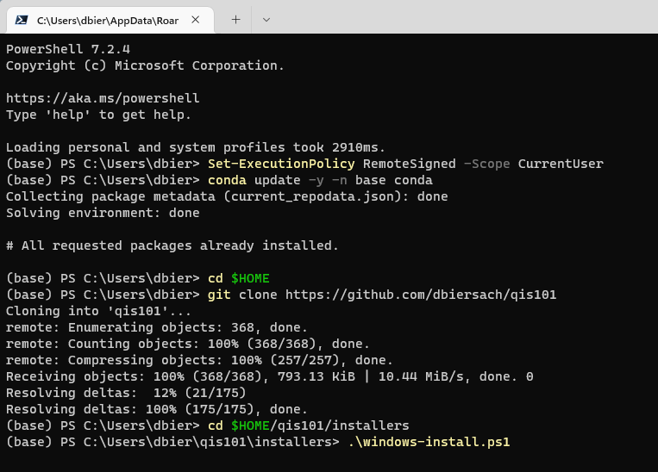
Microsoft Windows – Phase 2
Your screen might not look exactly like this
①
②
③
④
⑤
⑥

Slide 10
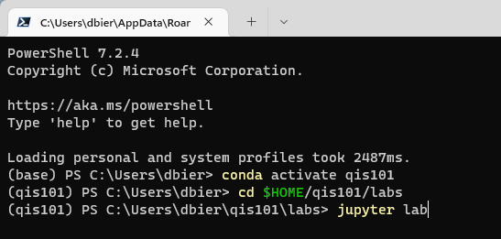
Microsoft Windows – Phase 3
Start a new PowerShell session and
execute these three commands (one line at a time):
conda activate qis101
cd $HOME/qis101/labs
jupyter lab
This step will open your default web browser
①
②
③

Slide 11
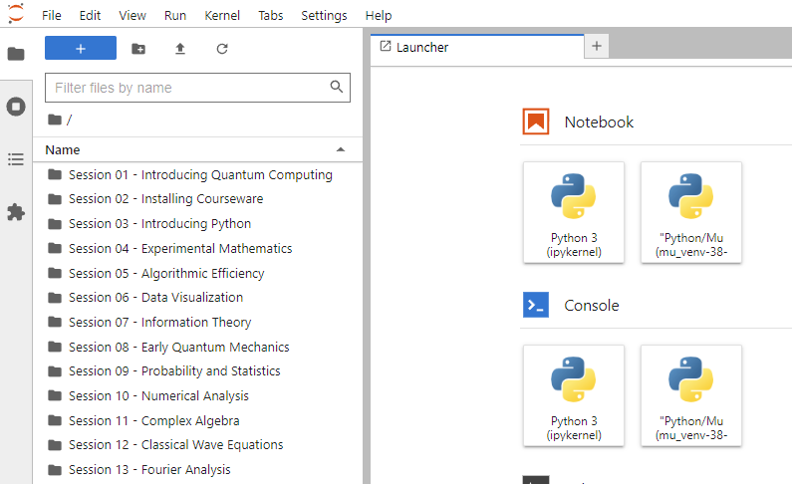
Microsoft Windows – Phase 4
Double click to open the Session 01 folder

Slide 12
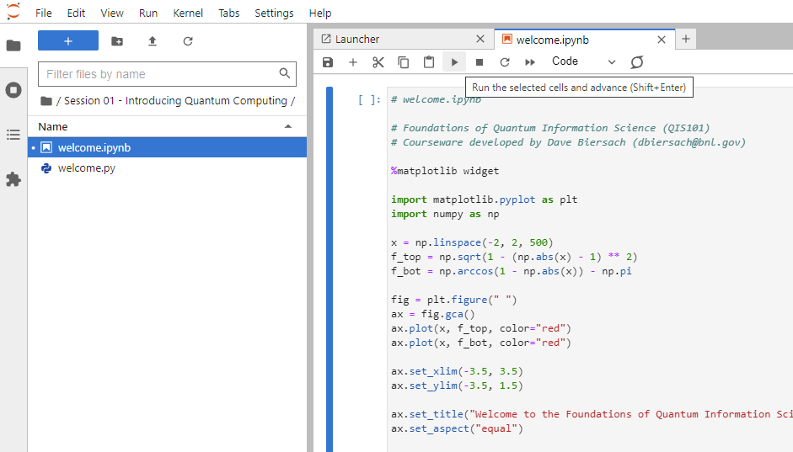
Microsoft Windows – Phase 4
… then click the "Play" button
Double click to open this file…

Slide 13

Microsoft Windows – Phase 4

Slide 14
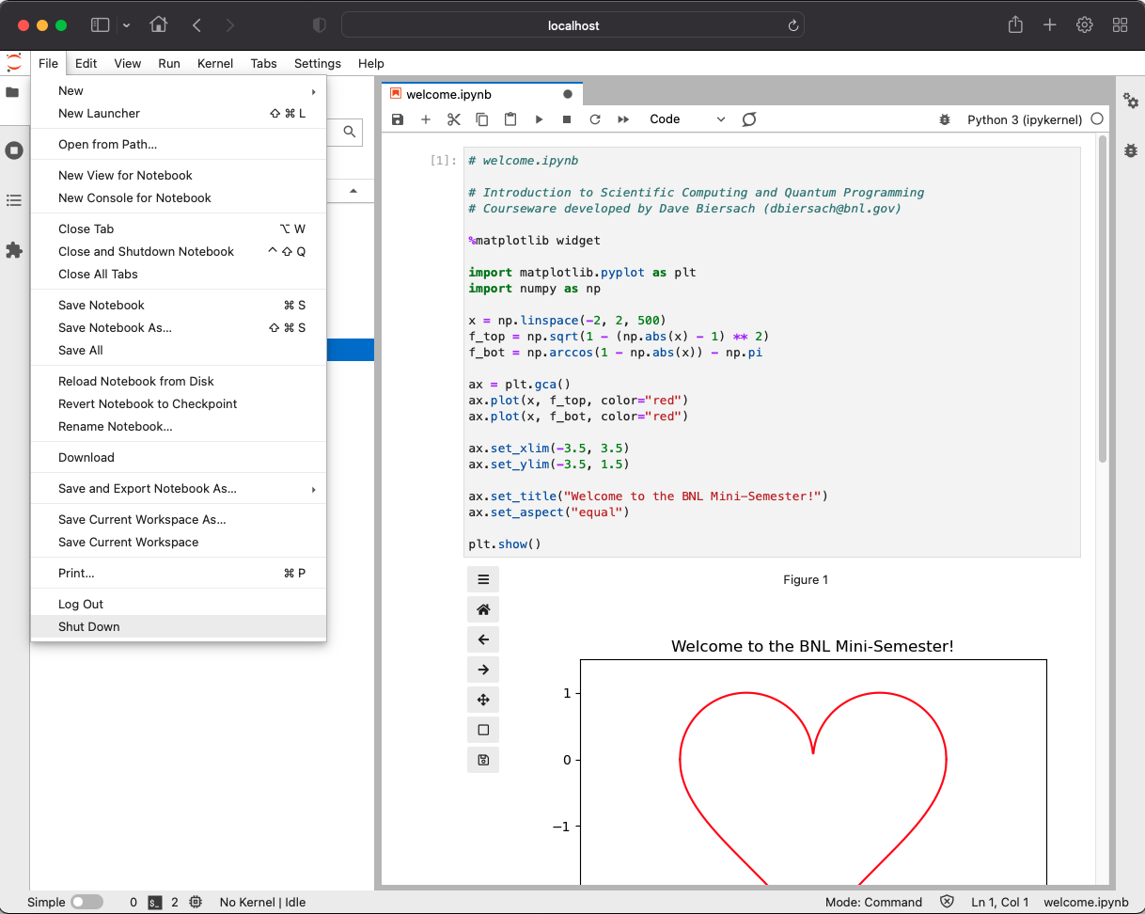
Microsoft Windows – Phase 4
Click the "Run" button
Select File…Shut Down, discard any changes, and then close this web browser window

Slide 15
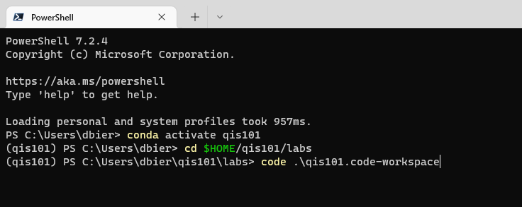
Microsoft Windows – Phase 5
Step 1 - Start a new PowerShell session and
execute these three commands (one line at a time):
conda activate qis101
cd $HOME/qis101/labs
code .\qis101.code-workspace
①
②
③

Slide 16
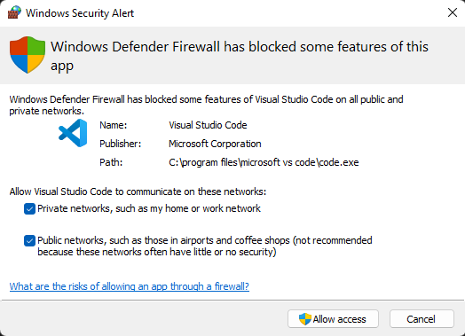
Microsoft Windows – Phase 5
Step 2 – If prompted, also select Private networks and
then click "Allow access"

Slide 17
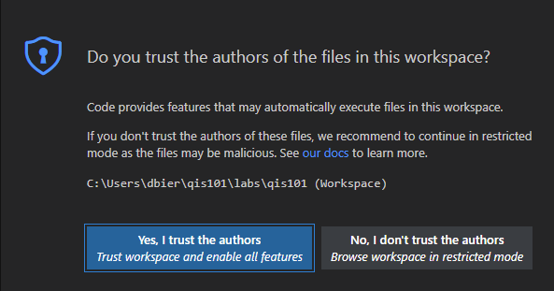
Microsoft Windows – Phase 5
Step 3 – If prompted, select "Yes, I trust the authors"

Slide 18
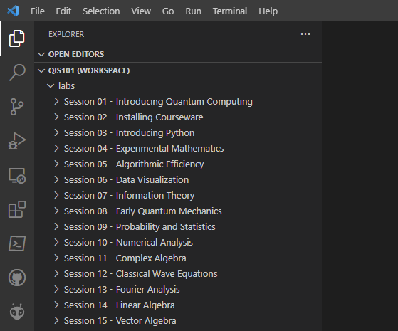
Microsoft Windows – Phase 5
Step 4 – Click the "Session 01" folder

Slide 19
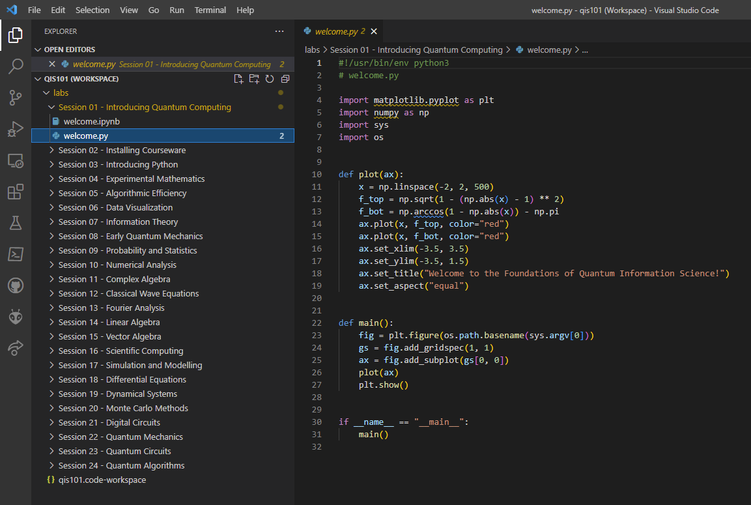
Microsoft Windows – Phase 5
Step 5 – Click the welcome.py file

Slide 20
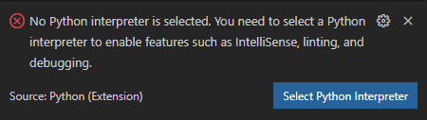
Microsoft Windows – Phase 5
Step 6 – If prompted, in the bottom right of the VS Code window,
click the "Select Python Interpreter" button

Slide 21
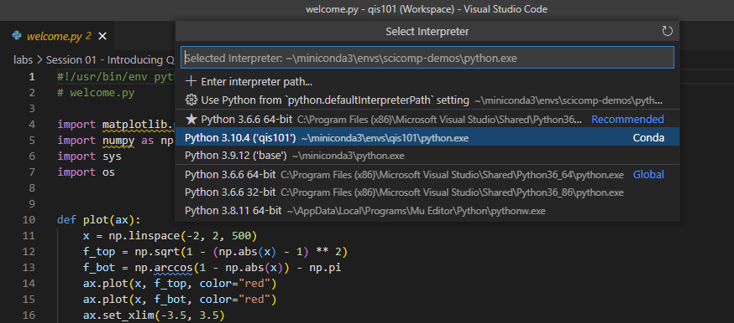
Microsoft Windows – Phase 5
Step 7 – If step 6 was necessary, now select
the QIS101 virtual environment in the dropdown list

Slide 22
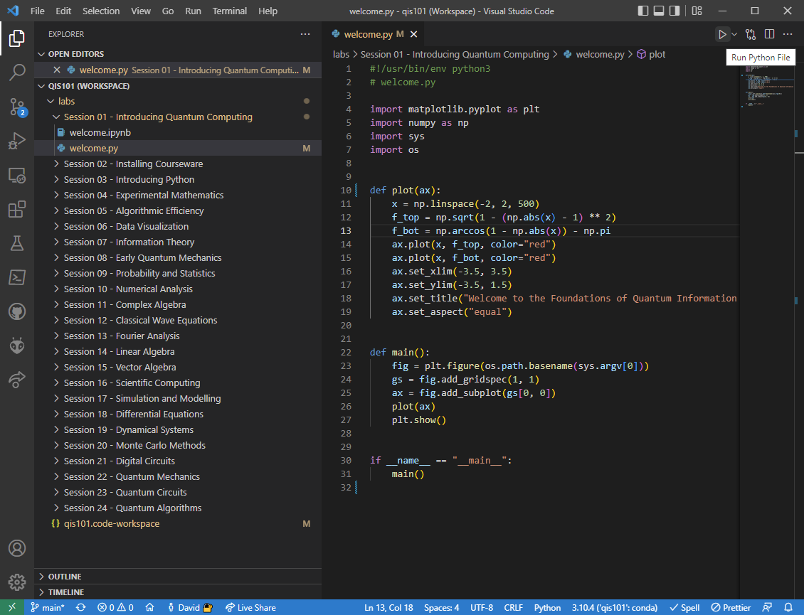
Microsoft Windows – Phase 5
Step 8 – Click the play button to run the Python program

Slide 23
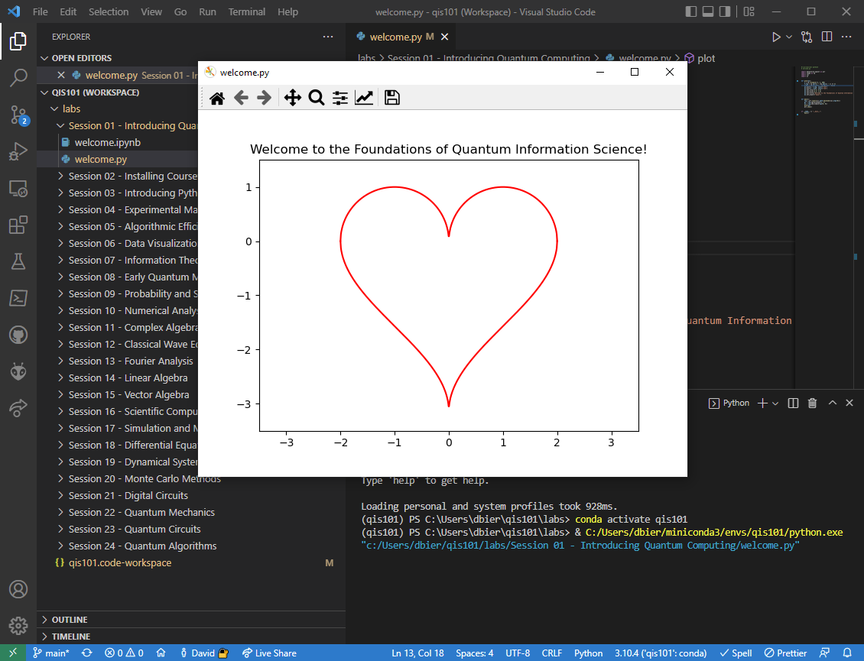
Microsoft Windows – Phase 5
Close this window and VS Code when you are done

Slide 24
Apple macOS – Phase 1
You must be running 64-bit macOS 11 (or later) with a minimum of 10GB of free disk space
Step 1 – Install Git - https://git-scm.com/download/mac using the homebrew install method for Git
Step 2 – Install Miniconda3 for macOS – first read this https://conda.io/projects/conda/en/latest/user-guide/install/macos.html and then do this (see next three slides)
If using an Intel CPU: download the script Miniconda3 MacOSX 64-bit bash https://repo.anaconda.com/miniconda/Miniconda3-latest-MacOSX-x86_64.sh
If using an M1 CPU: download the script Miniconda3 macOS Apple ARM bash https://repo.anaconda.com/miniconda/Miniconda3-latest-MacOSX-arm64.sh

Slide 25
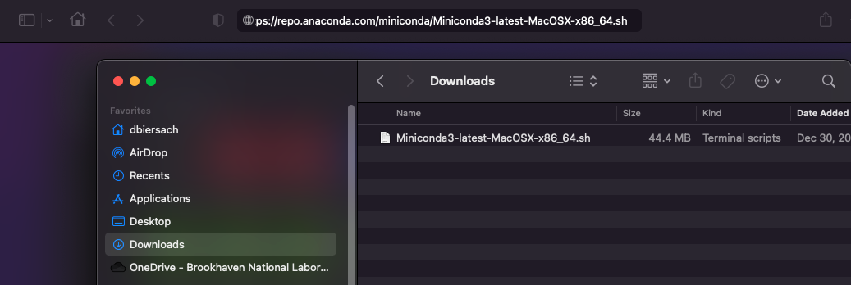
Apple macOS – Phase 1
After clicking on the appropriate script hyperlink in the prior slide (Phase 1 step #2a or #2b based upon your CPU type) your browser will place the script in your Downloads folder

Slide 26
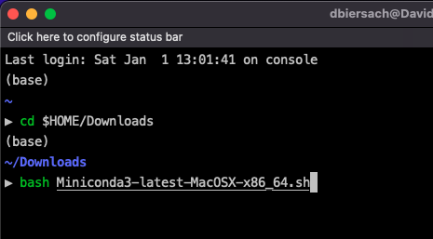
Apple macOS – Phase 1
To run the Miniconda install script that you downloaded,
open a new zsh (iTerm2) session, and execute these two commands:
cd $HOME/Downloads
bash Miniconda3-latest-MacOSX-x86_64.sh (if using an Intel CPU)
or
cd $HOME/Downloads
bash Miniconda3-latest-MacOSX-arm64.sh (if using an M1 CPU)
①
②

Slide 27
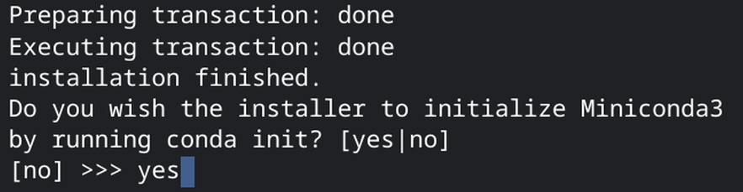
Apple macOS – Phase 1
When prompted as part of the Miniconda3 installer program, enter yes to initialize Miniconda3:

Slide 28
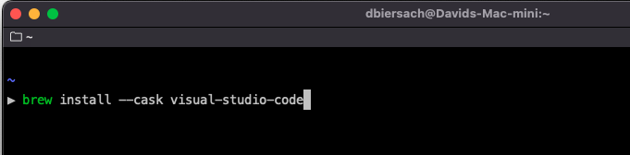
Apple macOS – Phase 1
Step 3 – Install Microsoft Visual Studio Code by executing this command: brew install --cask visual-studio-code

Slide 29
Apple macOS – Phase 2
After Phase 1 completes, close that zsh window, and then
start a new zsh (iTerm2) session and execute these four commands:
conda update -n base conda -y
cd $HOME
git clone https://github.com/dbiersach/qis101
source qis101/installers/mac-install.sh
Note: If when trying to run conda update… your computer says it cannot find 'conda'…
First, open a zsh session and change the working directory to the location of the conda executable on your filesystem. On macOS it is usually found in $HOME/opt/miniconda3/condabin
Then enter the following command: conda init zsh
Then close that zsh session, and restart Phase 2 on this slide

Slide 30
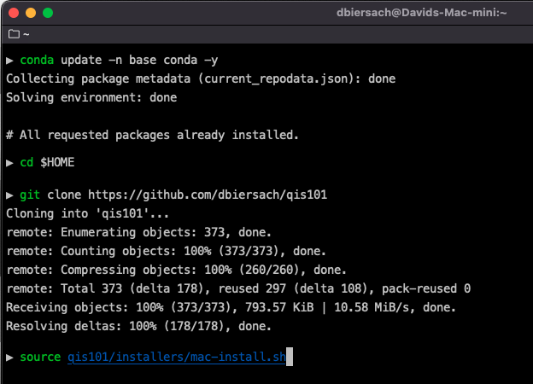
Apple macOS – Phase 2
①
Your screen might not look exactly like this
②
③
④

Slide 31
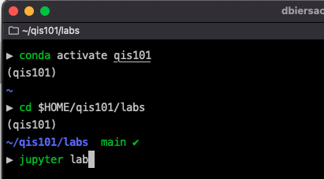
Apple macOS – Phase 3
Start a new zsh (iTerm2) session and execute these three commands:
conda activate qis101
cd $HOME/qis101/labs
jupyter lab
This step will open your default web browser
①
②
③

Slide 32
Apple macOS – Phase 4
Double click to open the Session 01 folder

Slide 33
Apple macOS – Phase 4
… then click the "Play" button
Double click to open this file…

Slide 34
Apple macOS – Phase 4

Slide 35
Apple macOS – Phase 4
Click the "Run" button
Select File…Shut Down, discard any changes, and then close this web browser window

Slide 36
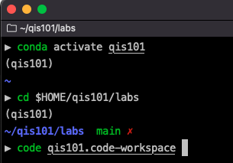
Apple macOS – Phase 5
Step 1 - Start a new zsh (iTerm2) session and
execute these three commands (one line at a time):
conda activate qis101
cd $HOME/qis101/labs
code qis101.code-workspace
①
②
③

Slide 37
Apple macOS – Phase 5
Step 2 – If prompted, select "Yes, I trust the authors"

Slide 38
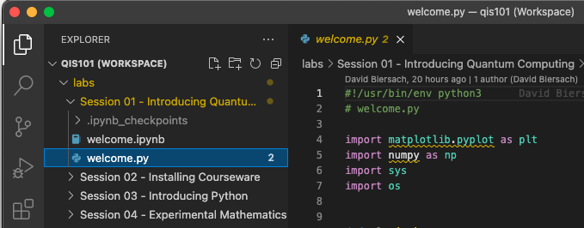
Apple macOS – Phase 5
Step 3 – Click on the Session 01 folder and then double-click on the welcome.py file to open it

Slide 39
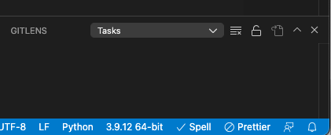
Apple macOS – Phase 5
Step 4 – If necessary, in the bottom right of the VS Code window,
click the "Select Python Interpreter" button
Otherwise, click on the Python Interpreter version label near the bottom-right of the main VS Code window

Slide 40
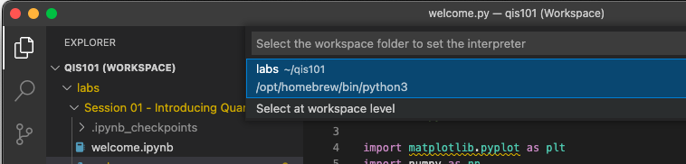
Apple macOS – Phase 5
Step 5 – Click the Select at workspace level option (if shown)
in the top center of the VS Code window

Slide 41
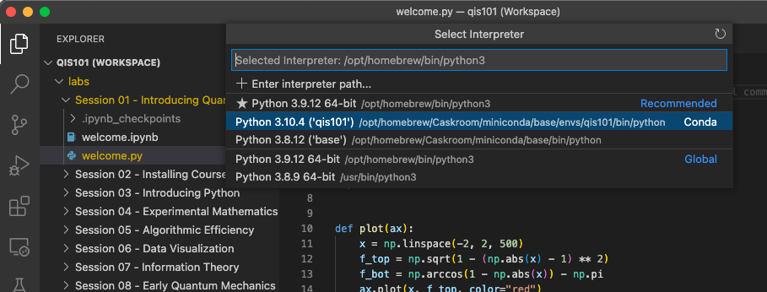
Apple macOS – Phase 5
Step 6 – Select the qis101 interpreter path
from the list of virtual environments on your computer

Slide 42
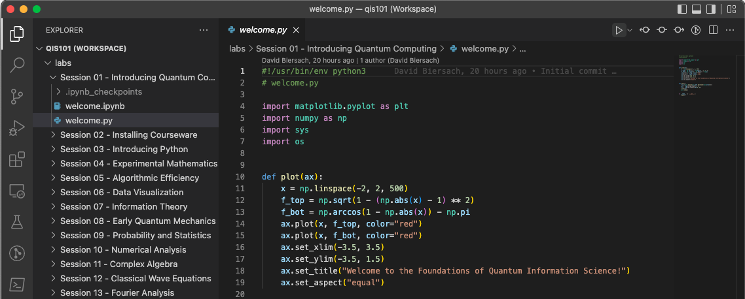
Apple macOS – Phase 5
Step 7 – Click the play button to run the Python program

Slide 43
Apple macOS – Phase 5
Close this window and VS Code when you are done

Slide 44
Ubuntu Linux – Phase 1
You must be running 64-bit Ubuntu 18.04 (or later) with a minimum of 10GB of free disk space
Step 1 – Install Git - https://git-scm.com/book/en/v2/Getting-Started-Installing-Git (I recommend installing via sudo apt install git-all)
Step 2 – Install Miniconda3 for Linux - read this first: https://docs.conda.io/projects/conda/en/latest/user-guide/install/linux.html - then do this (see next two slides)
If on an Intel PC: download the script Miniconda3 Linux 64-bit https://repo.anaconda.com/miniconda/Miniconda3-latest-Linux-x86_64.sh
If on an ARM PC: download the script Miniconda3 Linux-aarch64 64-bit https://repo.anaconda.com/miniconda/Miniconda3-latest-Linux-aarch64.sh

Slide 45
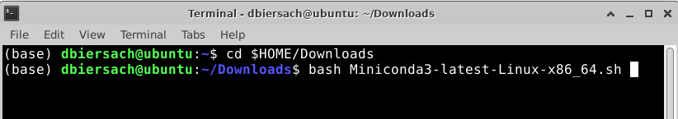
Ubuntu Linux – Phase 1
To run the Miniconda install script that you downloaded,
open a new Terminal session, and execute these two commands
cd $HOME/Downloads
bash Miniconda3-latest-Linux-x86_64.sh
or
cd $HOME/Downloads
bash Miniconda3-latest-Linux-aarch64.sh
①
②

Slide 46
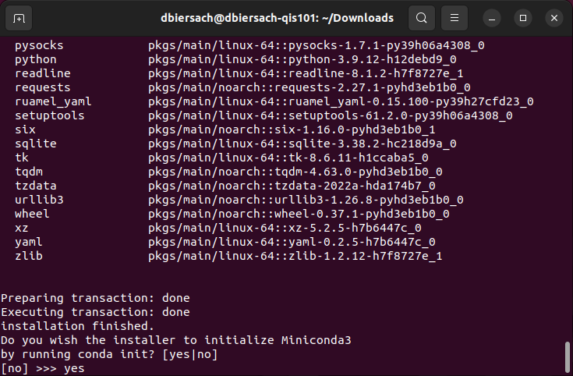
Ubuntu Linux – Phase 1
When prompted "Do you wish the installer to initialize Miniconda3 by running conda init? [yes|no]" enter yes
①

Slide 47
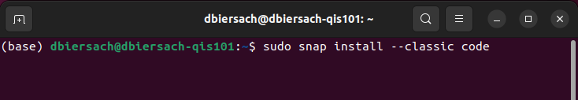
Ubuntu Linux – Phase 1
Step 3 – Close that terminal session and open a new terminal session – then install Microsoft Visual Studio code using a snap package: sudo snap install --classic code

Slide 48
Ubuntu Linux – Phase 2
After Phase 1 completes, close that terminal window, and then
start a Terminal session and execute these four commands:
conda update -n base conda -y
cd $HOME
git clone https://github.com/dbiersach/qis101
source qis101/installers/ubuntu-install.sh
Note: If when trying to run conda update… your computer says it cannot find 'conda'…
First, open a Terminal session and change the working directory to the location of the conda executable on your filesystem. On Ubuntu it is usually found in $HOME/opt/miniconda3/condabin
Then enter the following command: conda init bash
Then close that Terminal session, and restart Phase 2 on this slide

Slide 49
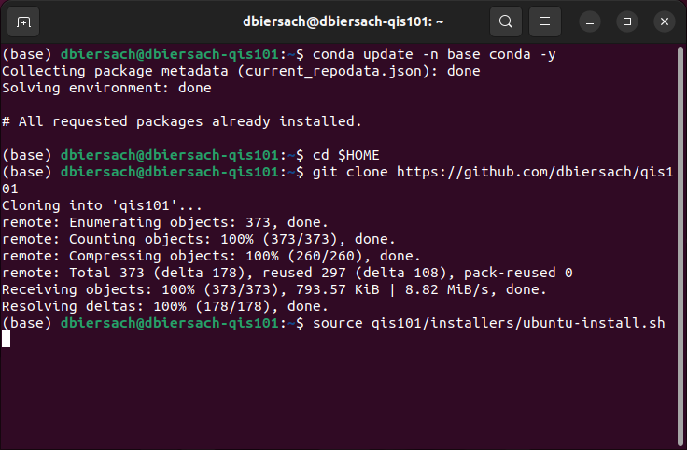
Ubuntu Linux – Phase 2
①
Your screen might not look exactly like this
②
③
④

Slide 50
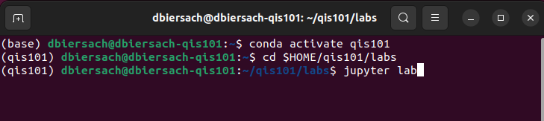
Ubuntu Linux – Phase 3
Start a new Terminal session and execute these three commands (one line at a time):
conda activate qis101
cd $HOME/qis101/labs
jupyter lab
This step will open your default web browser
①
②
③

Slide 51
Ubuntu Linux – Phase 4
Double click to open the Session 01 folder

Slide 52
Ubuntu Linux – Phase 4
… then click the "Play" button
Double click to open this file…

Slide 53
Ubuntu Linux – Phase 4

Slide 54
Ubuntu Linux – Phase 4
Click the "Run" button
Select File…Shut Down, discard any changes, and then close this web browser window

Slide 55
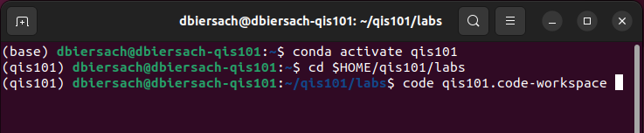
Ubuntu Linux – Phase 5
Step 1 - Start a Terminal session and
execute these three commands (one line at a time):
conda activate qis101
cd $HOME/qis101/labs
code qis101.code-workspace
①
②
③

Slide 56
Ubuntu Linux – Phase 5
Step 2 – If prompted, select "Yes, I trust the authors"

Slide 57
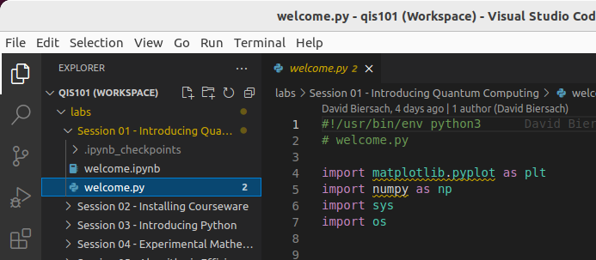
Ubuntu Linux – Phase 5
Step 3 – Click on the Session 01 folder and then double-click on the welcome.py file to open it

Slide 58
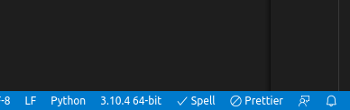
Ubuntu Linux – Phase 5
Step 4 – If prompted, in the bottom right of the VS Code window,
click the "Select Python Interpreter" button
Otherwise, click on the Python Interpreter version label near the bottom-right of the main VS Code window

Slide 59
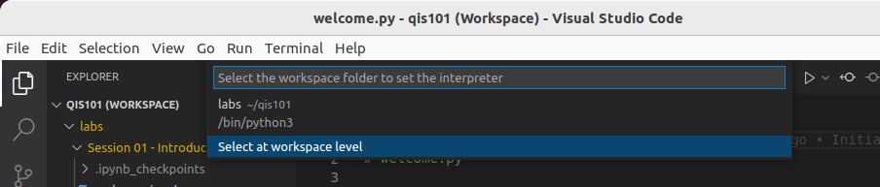
Ubuntu Linux – Phase 5
Step 5 – Click the Select at workspace level option (if shown)
in the top center of the VS Code window

Slide 60
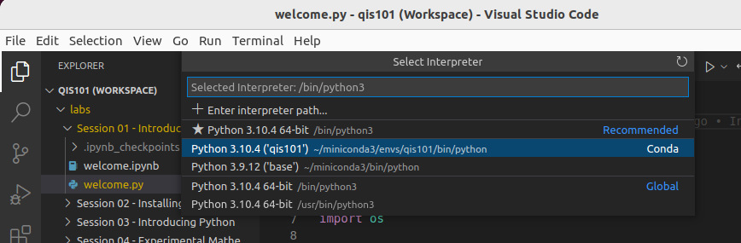
Ubuntu Linux – Phase 5
Step 6 – Select the qis101 interpreter path
from the list of virtual environments on your computer

Slide 61
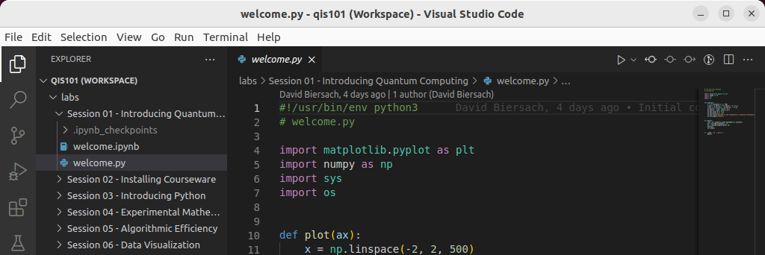
Ubuntu Linux – Phase 5
Step 7 – Click the play button to run the Python program

Slide 62
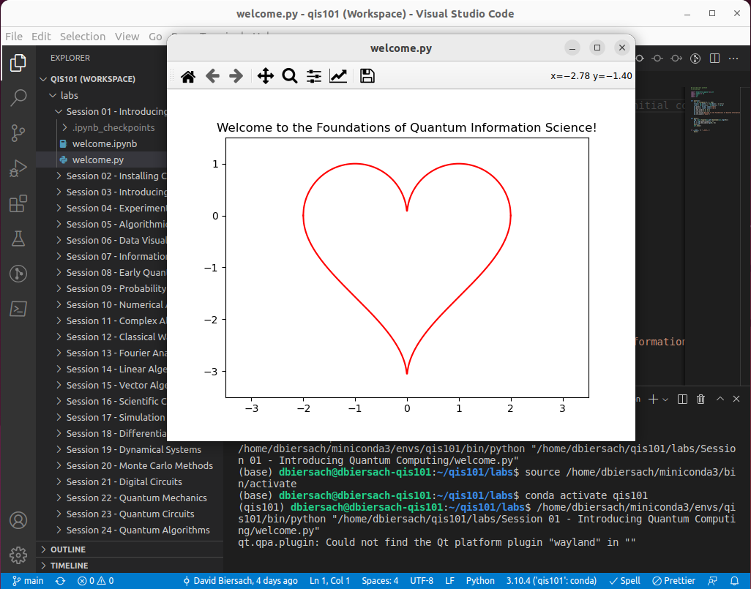
Ubuntu Linux – Phase 5
Close this window and VS Code when you are done

Slide 63
Google Chromebook Linux – Phase 1
You must enable 64-bit Linux on your Chromebook (Crostini) and have a minimum of 10GB of free disk space remaining in the Linux partition
Step 1 - Install Git – https://git-scm.com/book/en/v2/Getting-Started-Installing-Git using the command: sudo apt install git-all
Step 2 - Install Miniconda3 for Linux – first read this https://docs.conda.io/projects/conda/en/latest/user-guide/install/linux.html and then do this (see next three slides)
If on an Intel Chromebook: download and run the script Miniconda3 Linux 64-bit https://repo.anaconda.com/miniconda/Miniconda3-latest-Linux-x86_64.sh
If on an ARM Chromebook: download and run the script Miniconda3 Linux-aarch64 64-bit https://repo.anaconda.com/miniconda/Miniconda3-latest-Linux-aarch64.sh

Slide 64
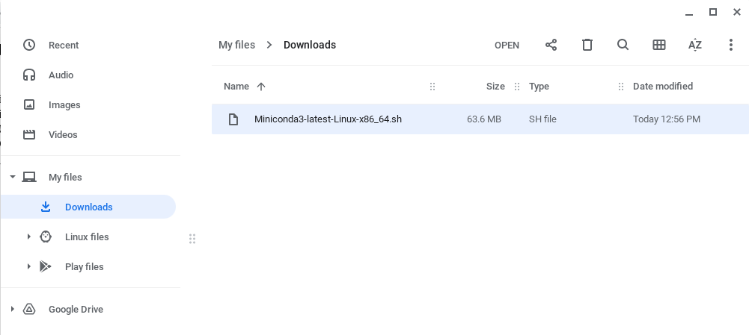
Google Chromebook Linux – Phase 1
After clicking on the appropriate script hyperlink in the prior slide (Phase 1 step # 2 a/b) based upon your CPU type, your browser will place the script in your Downloads folder:
Drag-n-Drop the script file from the Downloads folder to the Linux files folder

Slide 65
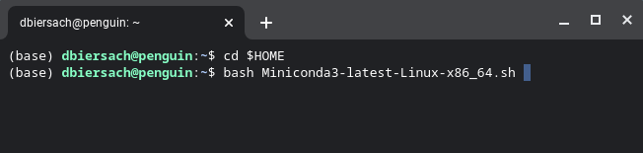
Google Chromebook Linux – Phase 1
To run the Miniconda install script that you downloaded,
open a new Terminal session, and execute these two commands
cd $HOME/Downloads
bash Miniconda3-latest-Linux-x86_64.sh (if on an Intel CPU)
or
cd $HOME/Downloads
bash Miniconda3-latest-Linux-aarch64.sh (if on an ARM CPU)
①
②

Slide 66
Google Chromebook Linux – Phase 1
When prompted "Do you wish the installer to initialize Miniconda3 by running conda init? [yes|no]" enter yes
①

Slide 67
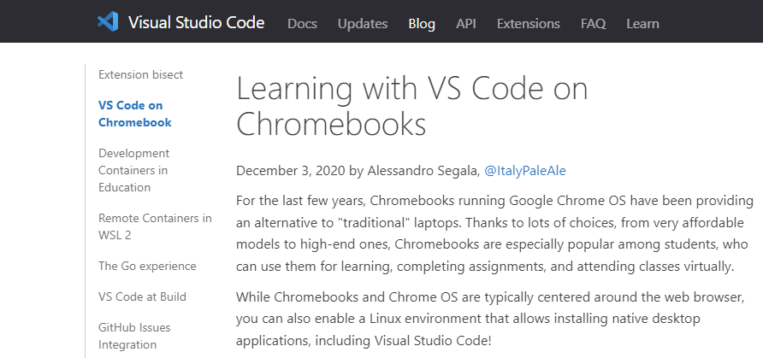
Google Chromebook Linux – Phase 1
Step 3 – Please follow the instructions on this page to install Microsoft Visual Studio Code on your Google Chromebook Linux (Crostini) container:
Learning with VS Code on Chromebooks

Slide 68
Google Chromebook Linux – Phase 2
After Phase 1 completes, close that terminal window, and then start a new Terminal session and execute these four commands:
conda update -y -n base conda
cd $HOME
git clone https://github.com/dbiersach/qis101
source qis101/installers/chromebook-install.sh
Note: If when trying to run conda update… your computer says it cannot find 'conda'…
First, open a Terminal session and change the working directory to the location of the conda executable on your filesystem. On Chromebook Linux, it is usually found in $HOME/miniconda3/condabin
Then enter the following command: conda init bash
Then close that Terminal session, and restart Phase 2 on this slide

Slide 69
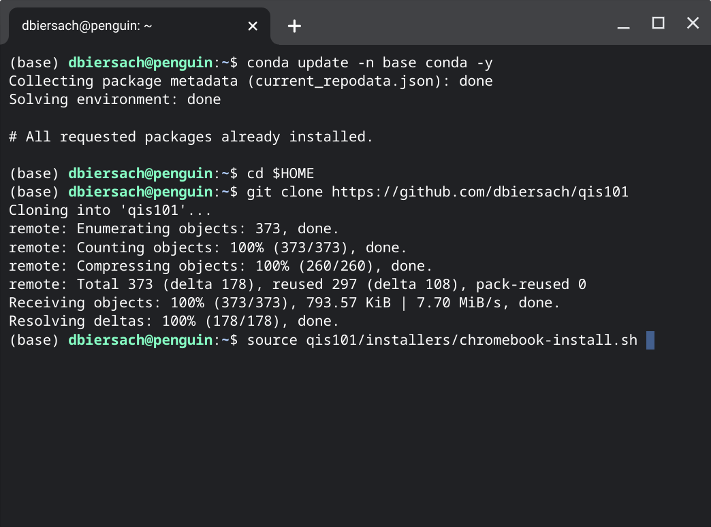
Google Chromebook Linux – Phase 2
①
Your screen might not look exactly like this
②
③
④

Slide 70
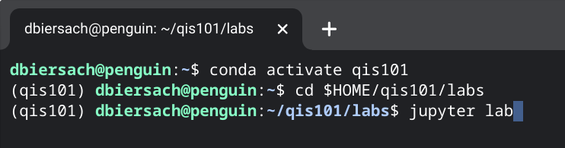
Google Chromebook Linux – Phase 3
Start a new Terminal session and execute these three commands:
conda activate qis101
cd $HOME/qis101/labs
jupyter lab
This step will open your default web browser
①
②
③

Slide 71
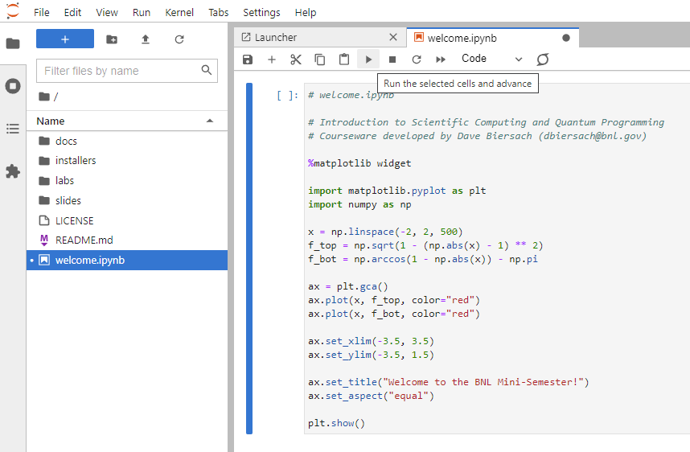
Google Chromebook Linux – Phase 4
Click the "Play" button
Double click to open this file

Slide 72
Google Chromebook Linux – Phase 4
… then click the "Play" button
Double click to open this file…

Slide 73
Google Chromebook Linux – Phase 4

Slide 74
Google Chromebook Linux – Phase 4
Click the "Run" button
Select File…Shut Down, discard any changes, and then close this web browser window

Slide 75
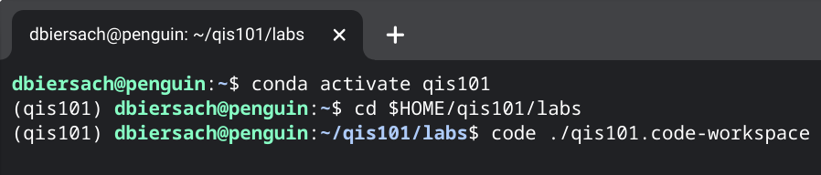
Google Chromebook Linux – Phase 5
Step 1 - Start a Terminal session and
execute these three commands (one line at a time):
conda activate qis101
cd $HOME/qis101/labs
code ./qis101.code-workspace
①
②
③

Slide 76
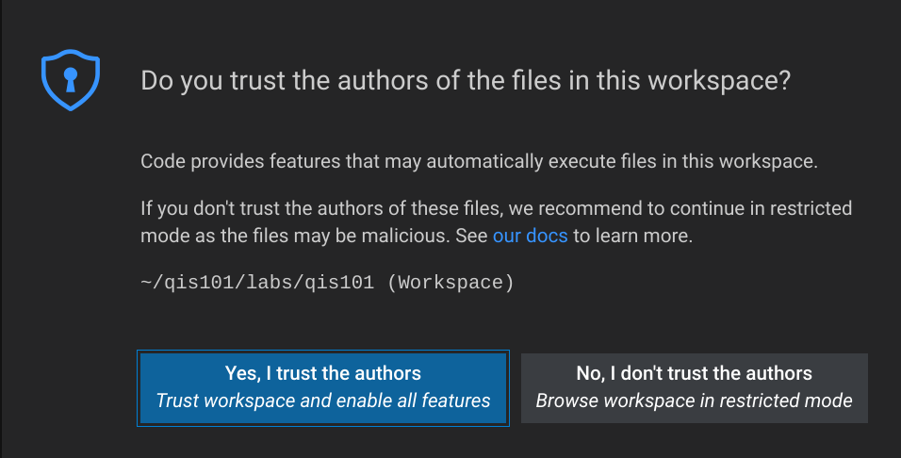
Google Chromebook Linux – Phase 5
Step 2 – If prompted, select "Yes, I trust the authors"

Slide 77

Google Chromebook Linux – Phase 5
Step 3 – Click on the Session 01 folder and then double-click on the welcome.py file to open it

Slide 78
Google Chromebook Linux – Phase 5
Step 4 – If necessary, in the bottom right of the VS Code window,
click the "Select Python Interpreter" button
Otherwise, click on the Python Interpreter version label near the bottom-right of the main VS Code window

Slide 79

Google Chromebook Linux – Phase 5
Step 5 – Click the Select at workspace level option
in the top center of the VS Code window

Slide 80

Google Chromebook Linux – Phase 5
Step 6 – Select the qis101 interpreter path
from the list of virtual environments on your computer

Slide 81

Google Chromebook Linux – Phase 5
Step 7 – Click the play button to run the Python program

Slide 82


Google Chromebook Linux – Phase 5
Close this window and VS Code when you are done

Slide 83
Troubleshooting Tip #1
If you are in a PowerShell or Terminal (bash/zsh) session, trying to run conda activate qis101 and your computer reports it cannot find 'conda'…
Manually locate the conda binary/executable on your filesystem and open a terminal session in that folder
Then type one of the following commands, based upon your platform:
For Microsoft Windows: conda init powershell
For Apple macOS: conda init zsh
For Ubuntu or Chromebook Linux: conda init bash
The command conda init will update your shell's path to include where the conda executable (program) can be located

Slide 84
Troubleshooting Tip #2
If you try to open a Jupyter Lab Notebook file (such as welcome.ipynb) and your default browser opens but then reports "file not found" or "access denied"…
Open a terminal session and type these two commands:
jupyter lab --generate-config
echo 'c.ServerApp.use_redirect_file = False' >> $HOME/.jupyter/jupyter_lab_config.py
The last command above appends an option to the end of the jupter_lab_config.py file to ensure ensure your browser can open a notebook file following the initial page redirection requested by the local Juptyer web server

Slide 85
TASK 02-01
Edit hello_world.py using Visual Studio Code to display your name and a witty short phrase
Email your TA with your updated hello_world.py program

